Slide 1
Mixed precision training
Zelei Shao

Slide 2
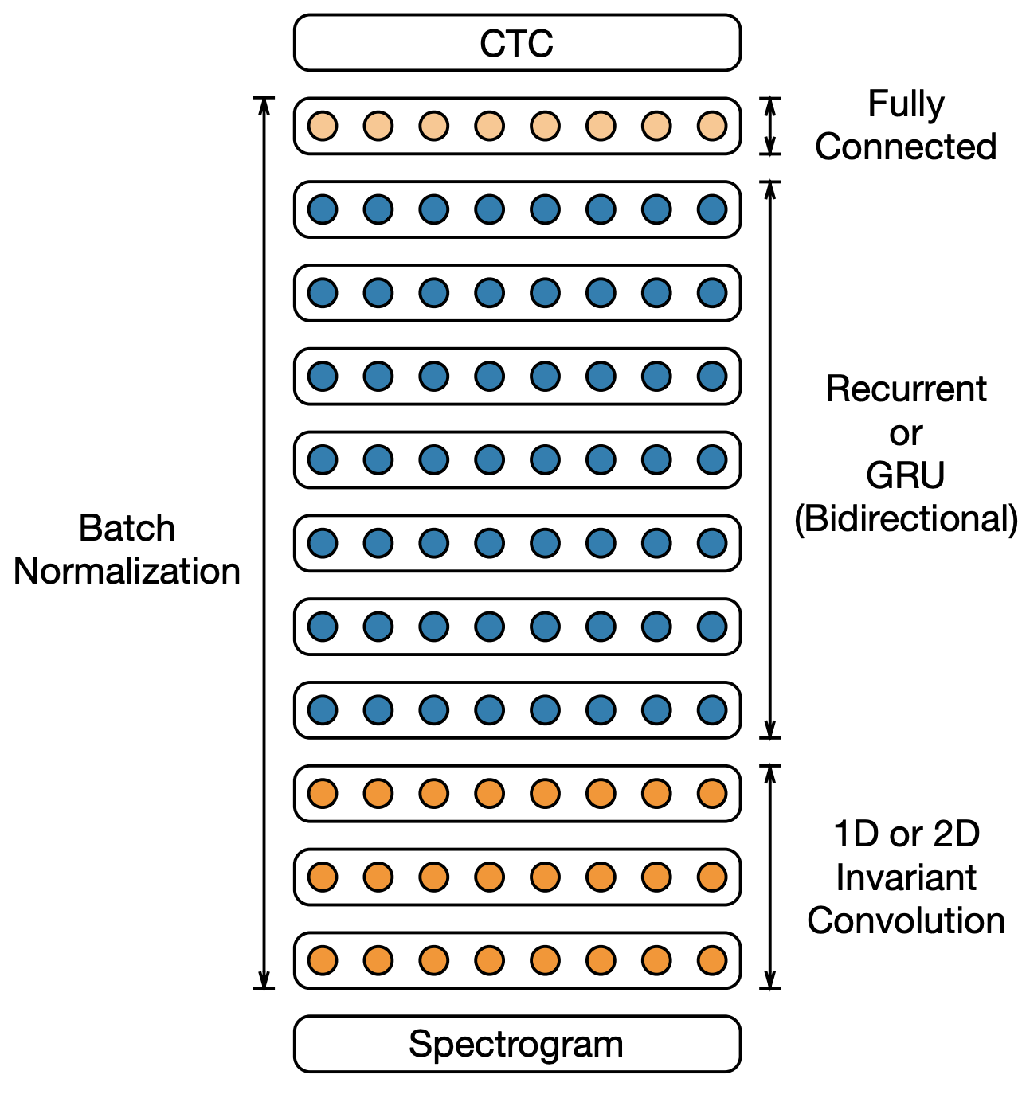
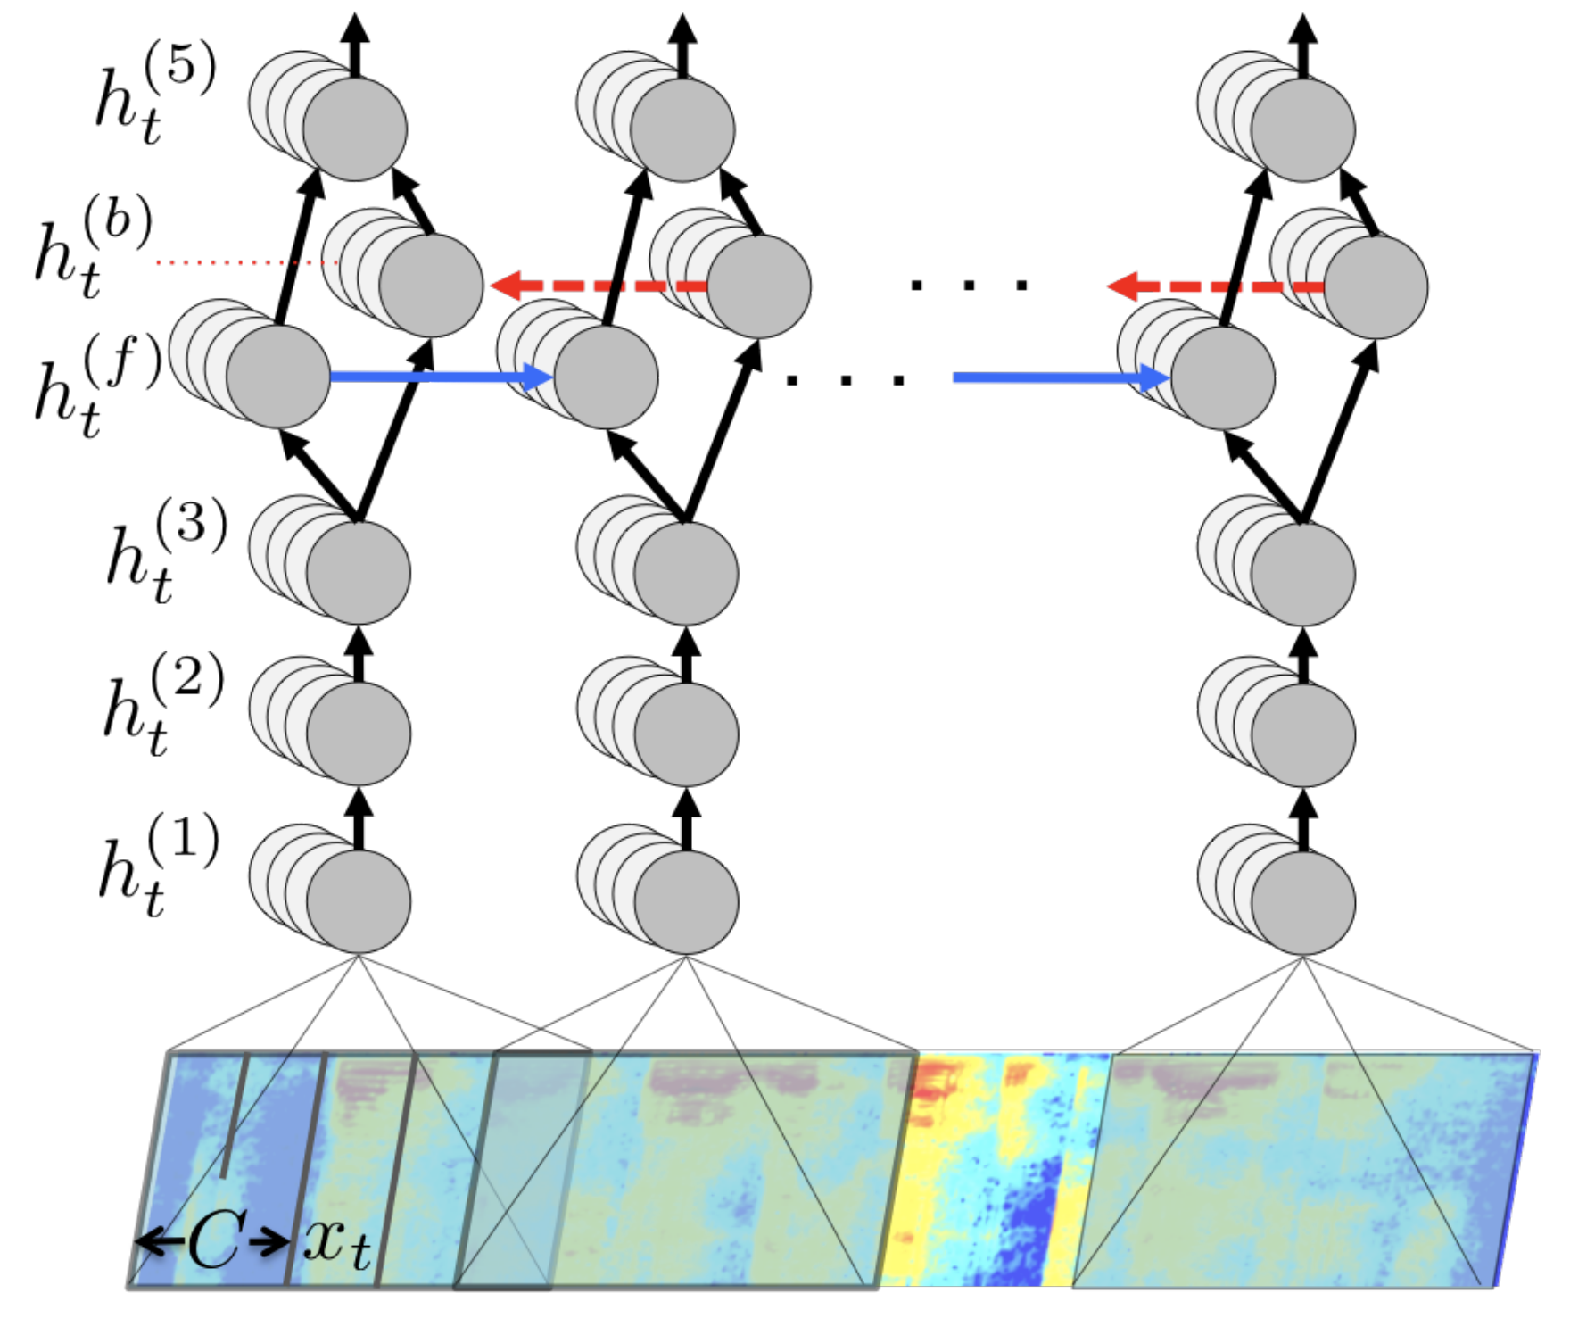
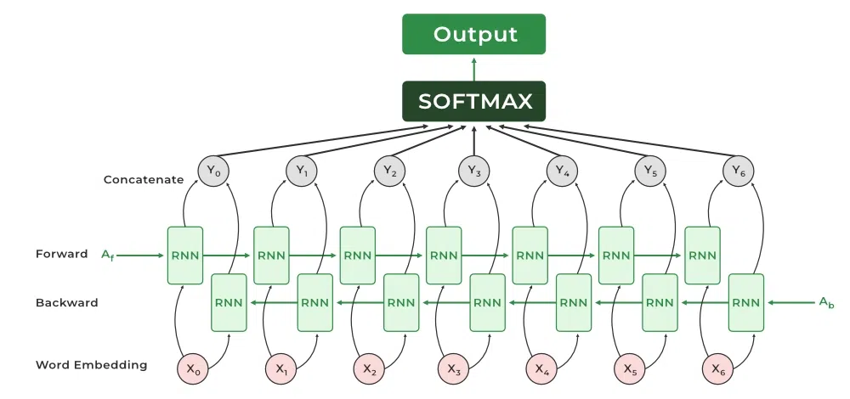
Motivation : big & complex model
Increasingly large training data sets and increasingly complex models.
11M
67M
116M
Notes:
Million

Slide 3
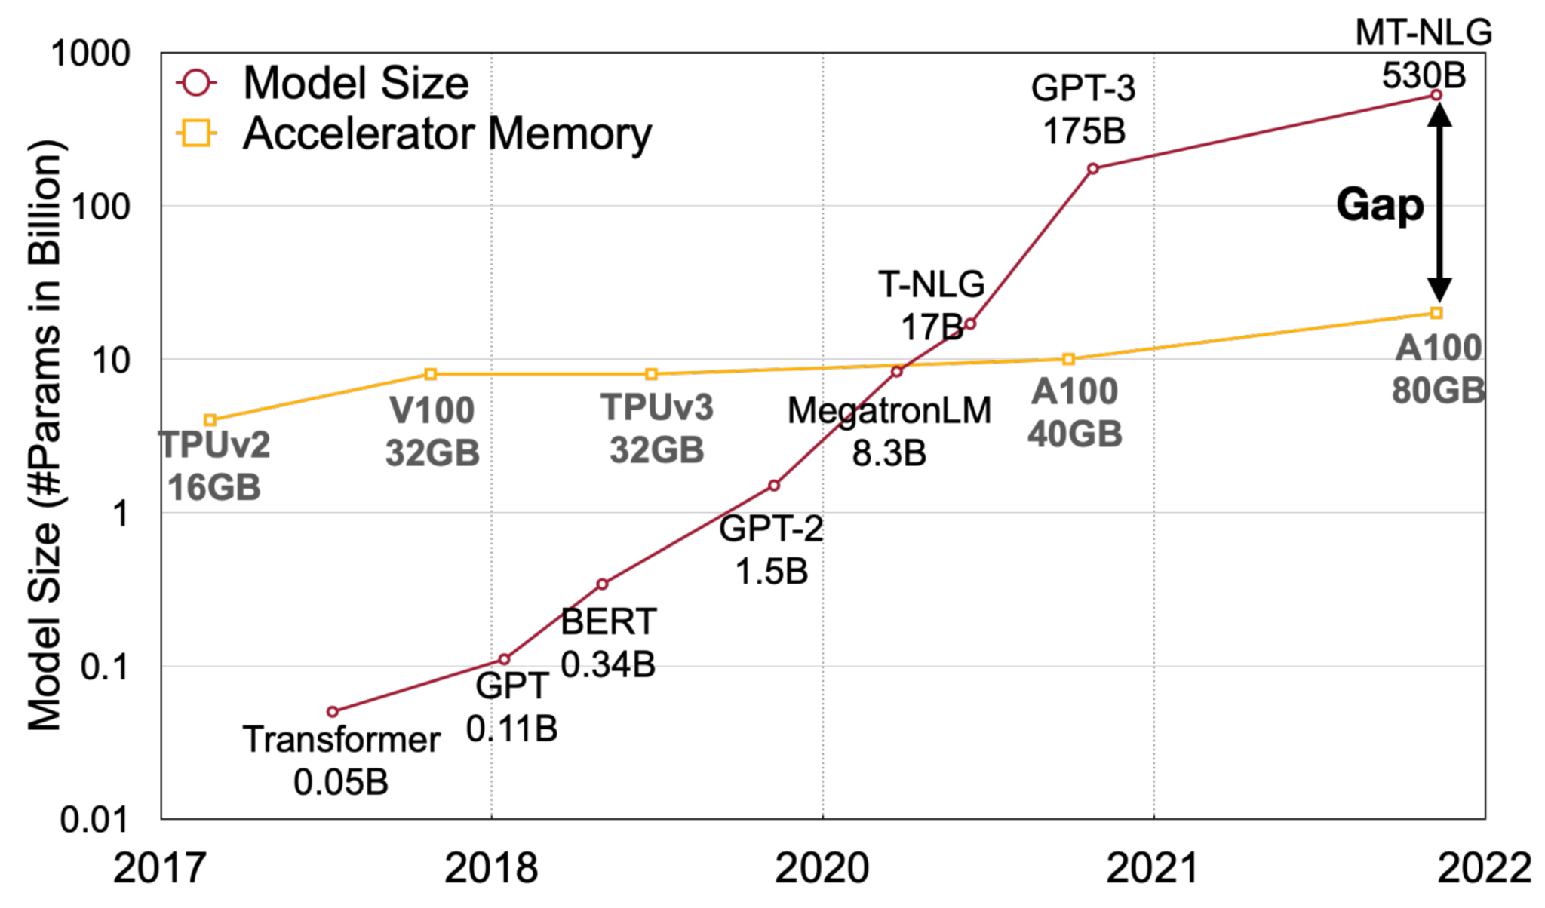
Motivation: memory and compute pressure
Memory and compute pressure when facing larger models.
a training process would take 2 weeks

Slide 4
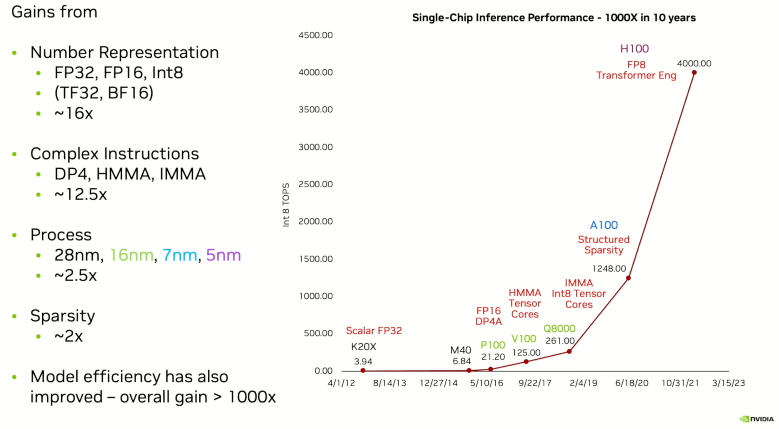
Reduce precision is a key contributor for performance
Notes:
Bill dally’s talk.

Slide 5
Existing works
Approach: fewer bits to improve performance
reduced precision : Courbariaux et al. (2015), . Gupta et al. (2015)
quantization : . He et al. (2016c) , Ott et al. (2016)
Limitation:
Non-trivial loss of accuracy.
Lacks generality to other models.
Not clear whether their results hold for larger networks needed for larger datasets
Require tuning hyper-parameters(such as layer width).
Limited use of fp16.
The gradients are unmodified using single precision.

Slide 6
The goal of this paper
Offer a mixed precision training method :
Keep the model accuracy same as single precision training.
Can be applied to a wide range of models without requiring modifications.
Reduces memory usage, and increases throughput.

Slide 7
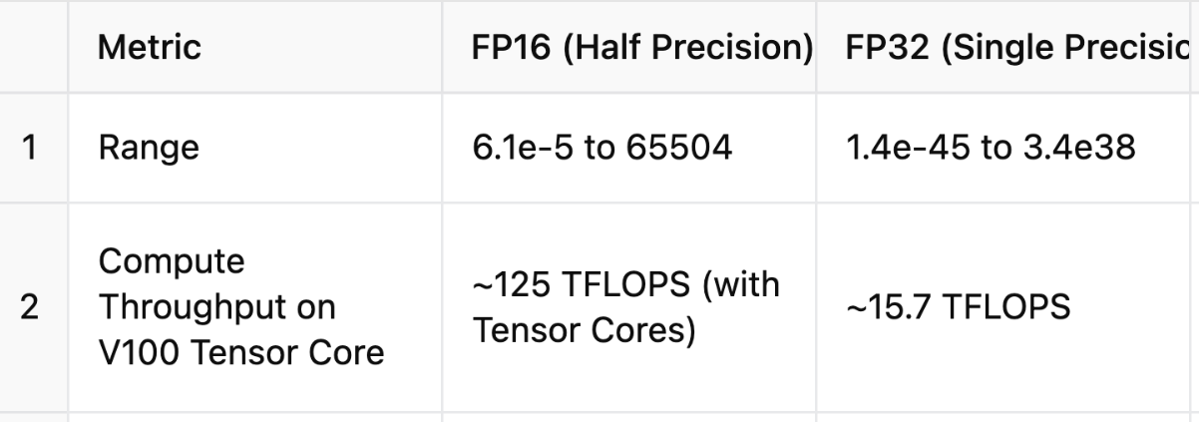
Background: FP16 & FP32
Tradeoff between accuracy and compute throughput.

Slide 8
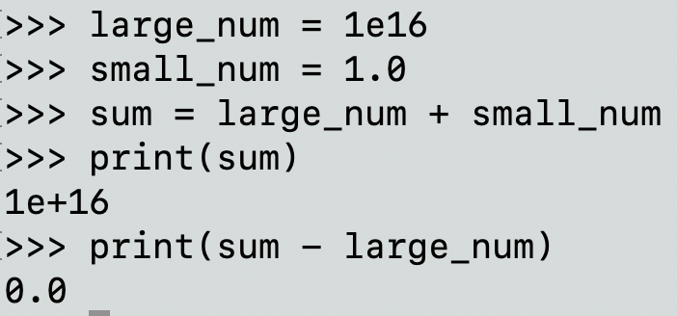
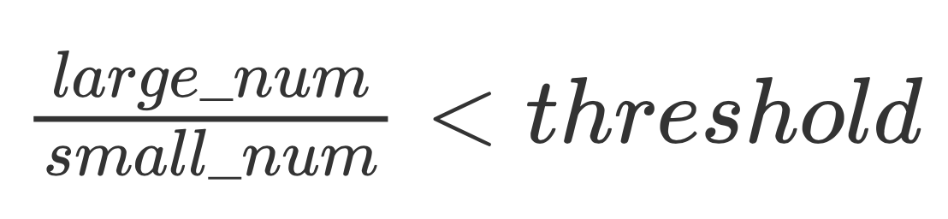
Background : Loss of Significance
Reason : the large gap in their magnitudes
If then no loss.
threshold : FP16 is ~10^3 FP32 is ~10^7.

Slide 9
Key designs
“Master” weights in fp32 : imprecise weight updates
loss-scaling : Gradient underflow
Accumulate to fp32 : Reductions overflow

Slide 10
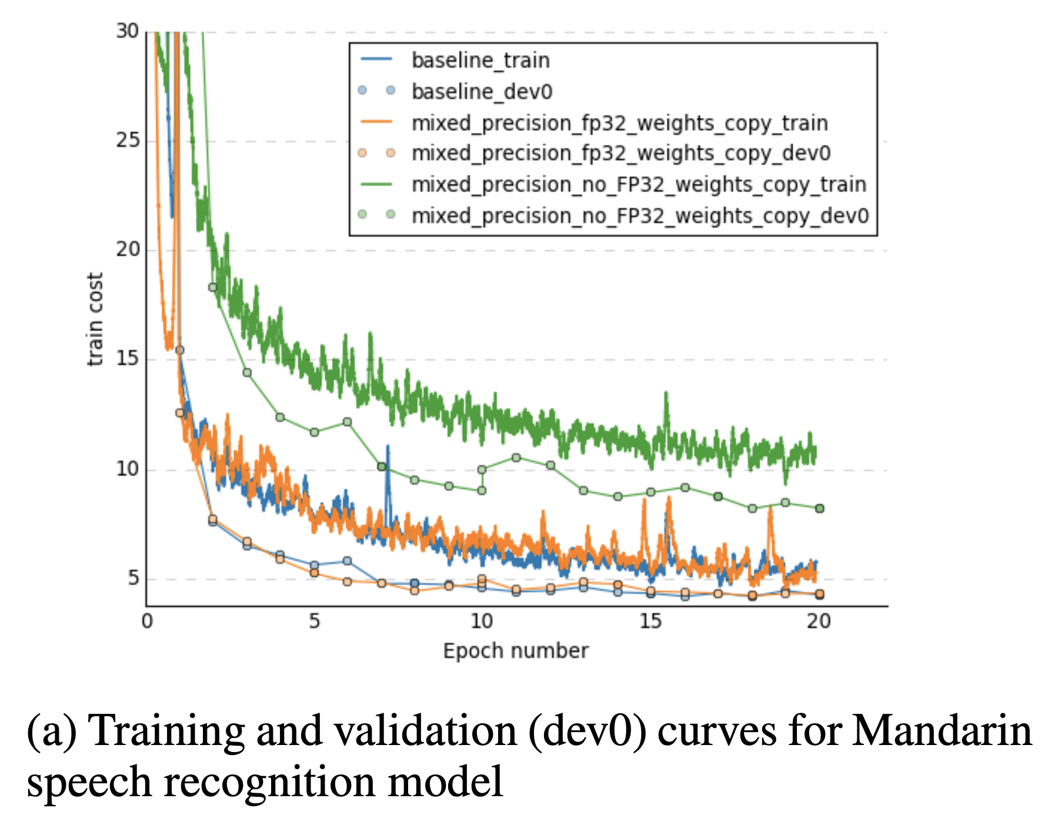
“Master” weights in fp32
Motivation :
Guarantee accuracy
Don’t cost huge memory consumption(memory consumption is dominated by activations).
Notes:
Transformer’s memory consumption is bounded by ?

Slide 11
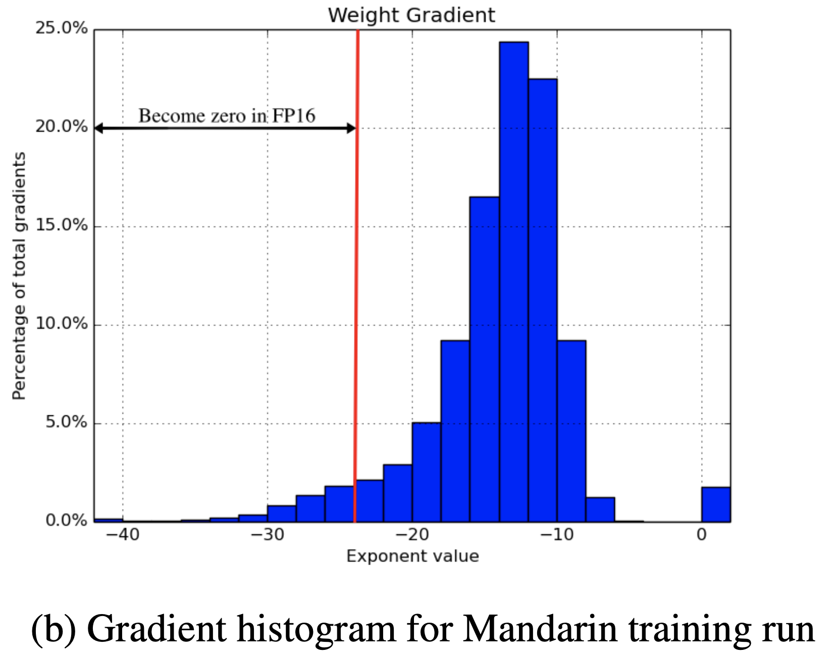
“Master” weights in fp32
Accuracy loss have 2 reasons:
Updates underflow in fp16
update : weight gradients multiplied by the learning rate
Loss of significance in fp16:
large weights
small gradient updates

Slide 12
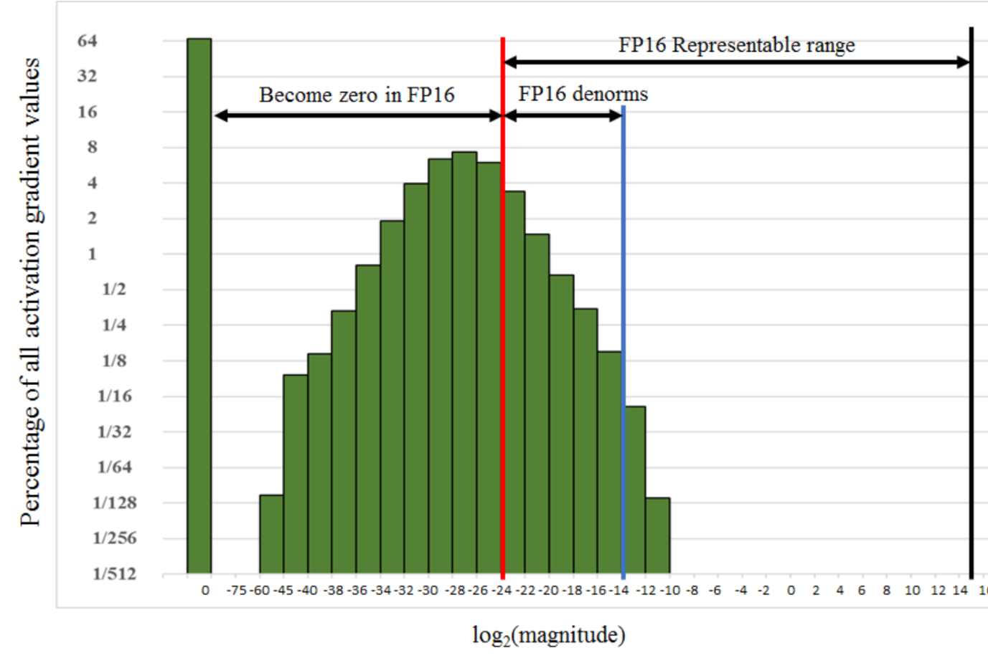
2. loss-scaling
Motivation:
to fully utilized FP16 repersentable range
solve gradient underflow problem
all the gradient values are scaled by the same amount : requires no extra operations

Slide 13
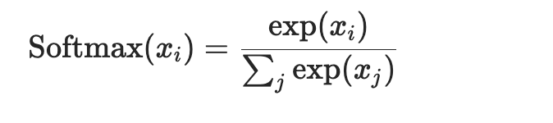
3. Accumulate to fp32
motivation : avoid big reduction overflow
sums across elements of a vector
SoftMax.
Batch-normalization
statistics (mean and variance) computed by batch-normalization

Slide 14
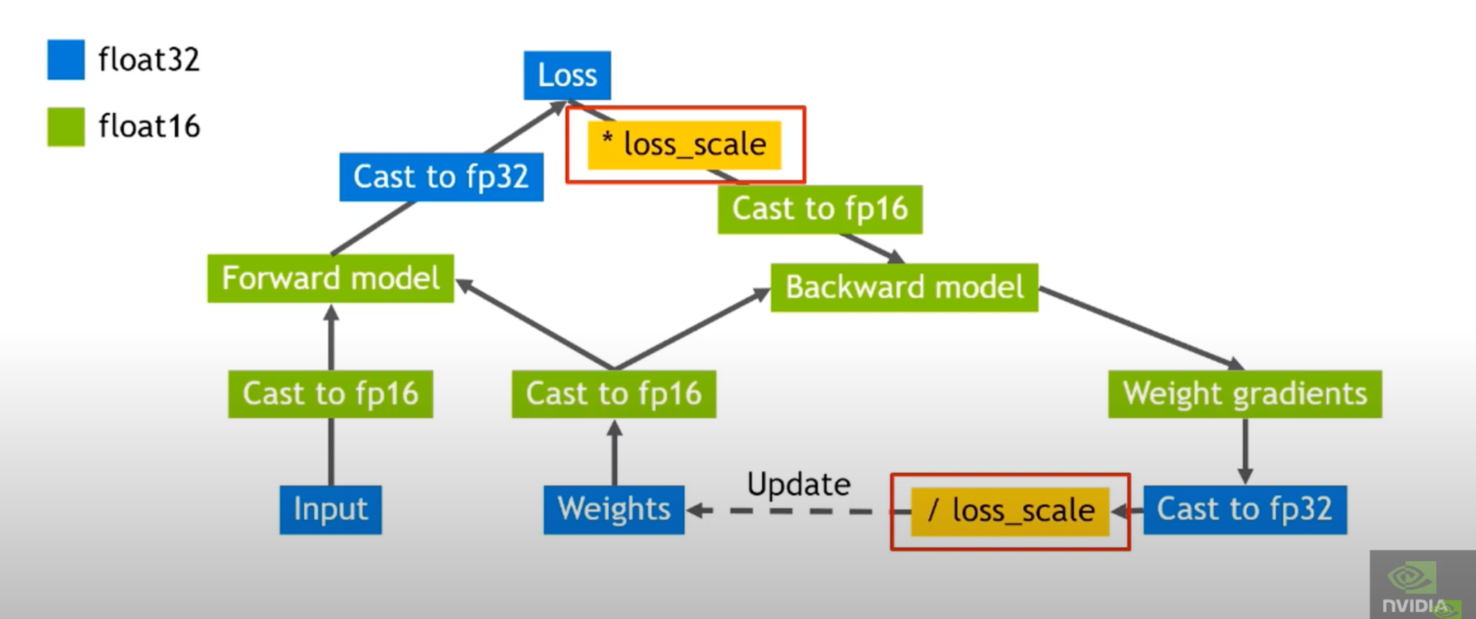

Slide 15
Experiments goal
Use experiments to answer these questions:
Is the accuracy loss similar to fp32 training?
Did it take effect on a wide range of models and tasks?
Can we reduce memory usage, and increase throughput.

Slide 16
Evaluation setup
Baseline(FP32) :
Storage & Arithmetic all in FP32.
hardware : Maxwell or Pascal GPU
Mixed Precision training method(MP) :
Storage & Arithmetic : FP16 + FP32.
Loss-scaling is used for some applications
hardware : Volta V100(first GPU has tensor cores supporting FP16 )
test on multiple network architectures and applications, verify that mixed-precision algorithms do not introduce a loss of precision

Slide 17
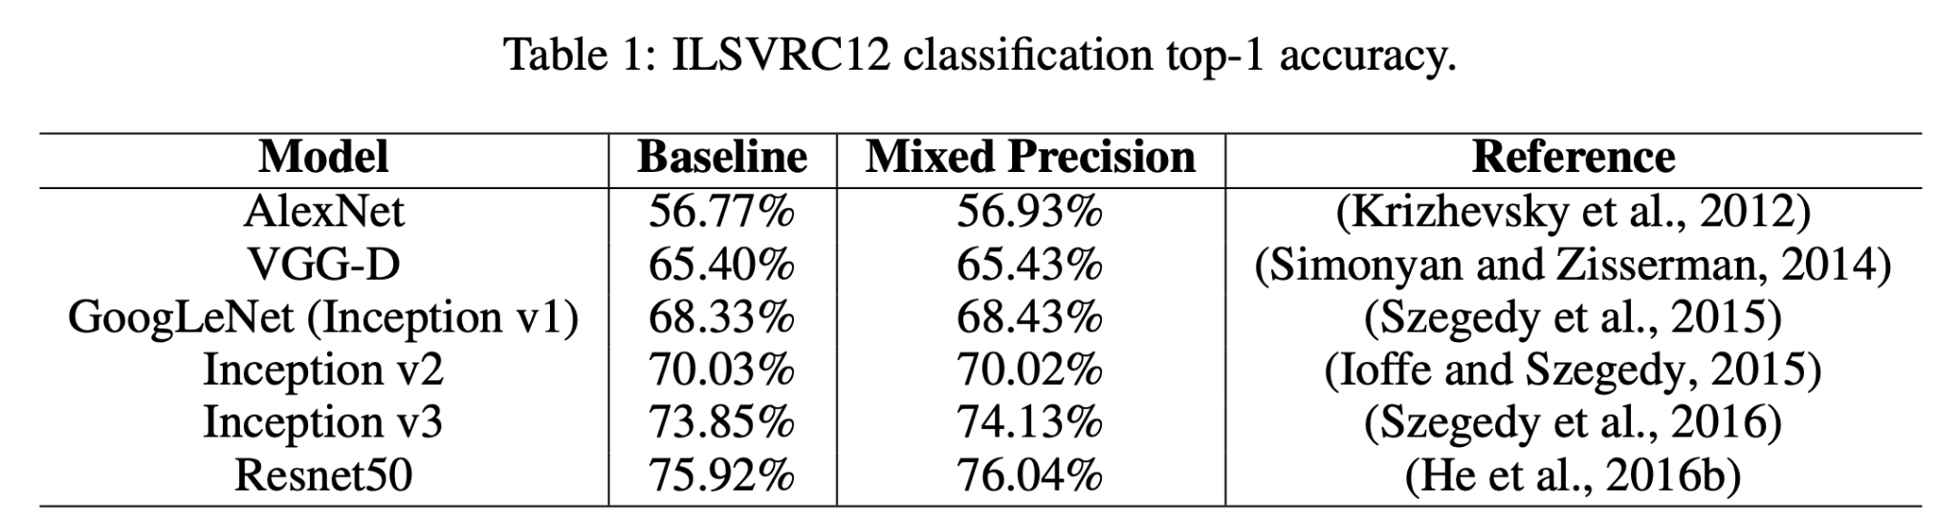
classification task
CNN-based model for ILSVRC classification task

Slide 18
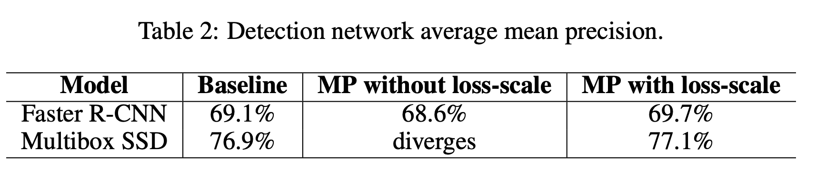
detection tasks
CNN-based model on object detection tasks

Slide 19
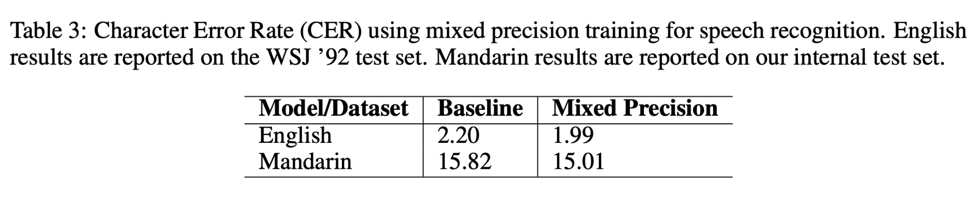
Speech recognition task

Slide 20
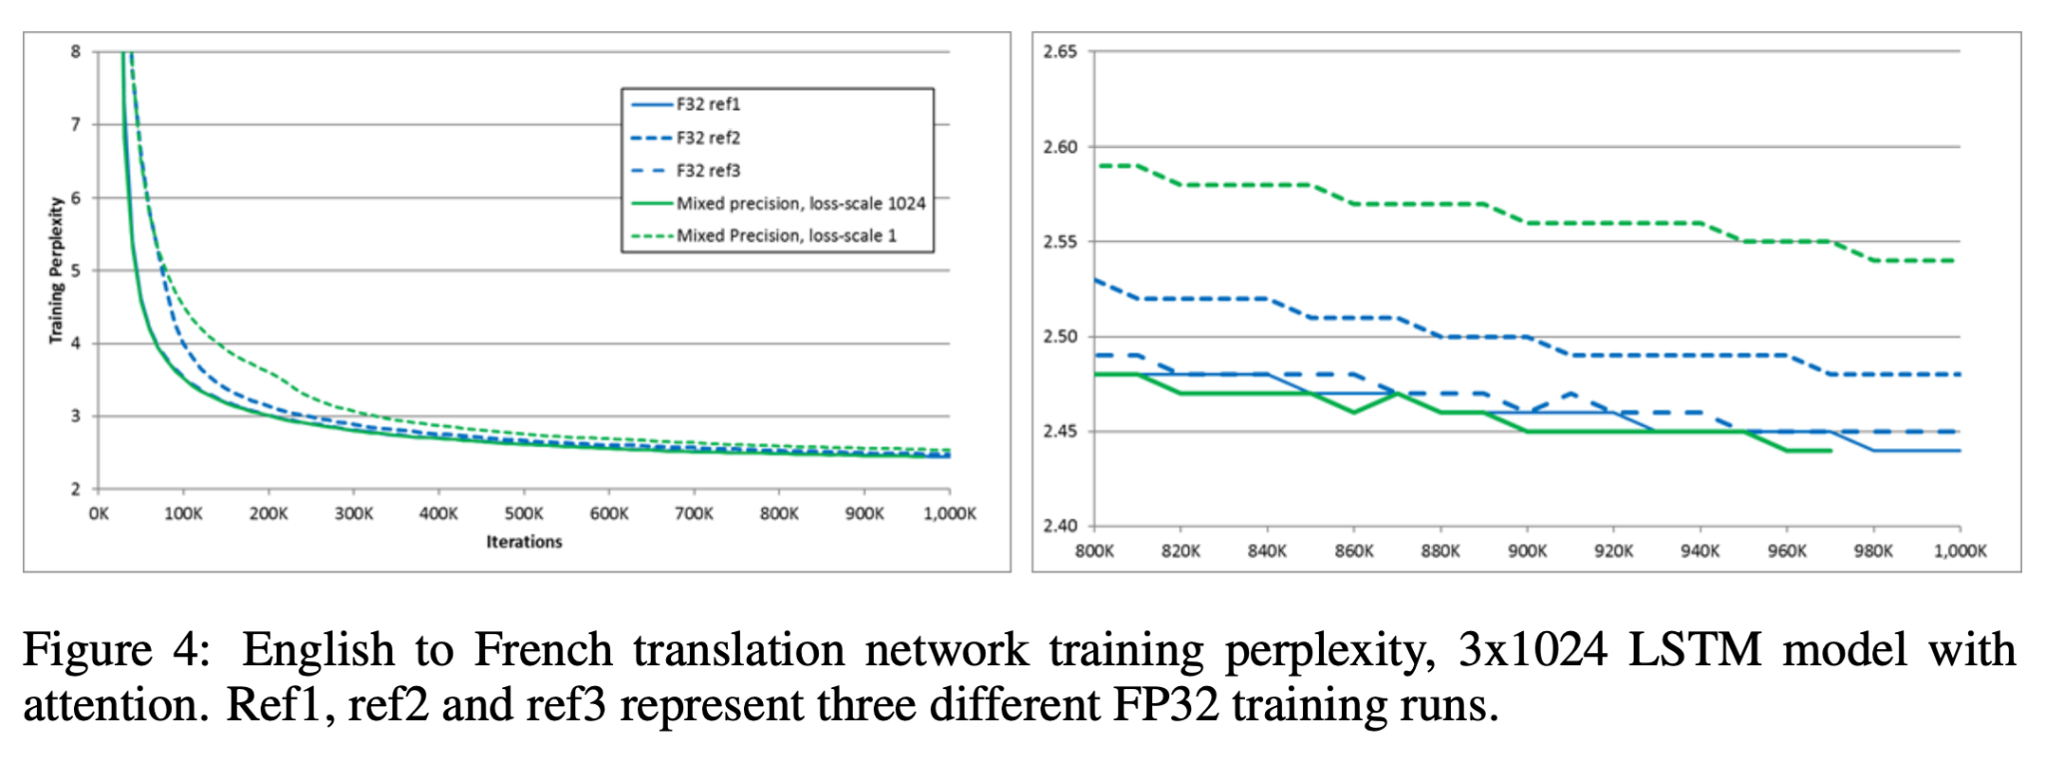
language translation tasks:

Slide 21
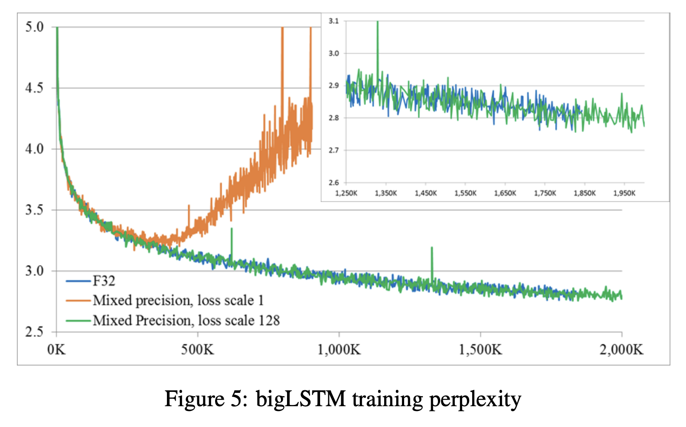
language model

Slide 22
Strengths and weaknesses
strengths :
Well-motivated problem: now widely used.
perform great : no accuracy loss, fit to modern architecture
easy-to-use: no customization to different models.
weakness :
evaluation missing: no results about memory consumption & compute throughput.
maybe hard to choose scaling factor : overflow & underflow

Slide 23
Future Directions
Automating loss-scaling factor selection
Lower Precision Formats : 8bit, 4bit, …
Generalize it to new models.
Attention based model: memory bottleneck are the model states.
The assumption that activation is the memory bottleneck doesn’t hold.

Slide 24
Any questions?

